Slide 1
ESL Enrichment
Mrs. Holloway- P2,P3, P7
Week of April 27, 2020

Slide 2
Eagle Exercise
Examples of multiple-meaning words
Use context clues and look at how each word is used in the sentence.
fan A. The fan cheered for her team.
B.There was only a fan to keep us cool.
What does the word fan mean in example A?
What does the word fan mean in example B?

Slide 3
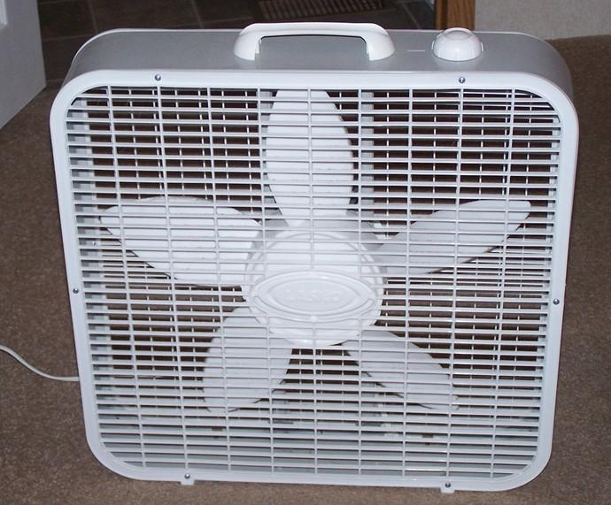
Eagle Exercise Examples of multiple-meaning words
Use context clues and look at how each word is used in the sentence.
fan A. The fan cheered for her team.
B.There was only one fan to keep us cool.
What does the word fan mean in example A? A person that supports a team.
What does the word fan mean in example B?
An electric device with blades that turn quickly and is used to move air around.

Slide 4
Your Turn: Multiple-meaning Words
multiple-meaning words
Use context clues and write what you think each word means.
lap A. I held the plate in my lap.
B. We ran one lap around the track.
What does the word lap mean in example A?
What does the word lap mean in example B?

Slide 5
Supplies:Make sure that you have at least 3 sheets of paper and something to write with!
Directions: Create a 4 column graphic organizer chart and label it:
Type of Clue/ What It Does/ Signal Words or Punctuation/ Examples

Slide 6
Watch the video and take notes on your graphic organizer.
(Click the on the board to watch the video)
Context Clues- I-Ready

Slide 7
This is what your graphic organizer should look like!

Slide 8
https://drive.google.com/file/d/1svx4EIZfCNpaCE6aaQFKW-U0z70cn9dp/view
Click on this link and get the context clues activity pages.

Slide 9
Anna’s Monster ( A Narrative Poem)
Stanza 1
I’m scared of the darkness, I don’t care who knows it,
I don’t like the darkness at all.
I sleep with the lights on—two lights in my room,
And a much brighter light in the hall.
I’m frightened of monsters that might come and get me,
Whenever I climb into bed.
My mother says, “Anna, you’re just being silly,
The monsters are all in your head!”
Stanza 2
But I don’t think that’s true, because of what happened
Last night, the first day of the week.
I put on my nightgown, got under the covers—
Rolled over, and heard a strange squeak.
It wasn’t a mouse, and it wasn’t a rabbit,
It wasn’t a dog or a cat.
So I screamed out in terror. My mother came running!
“Whatever,” she asked me, “was that?”

Slide 10
Anna’s Monster by Justin Nuñez ( A Narrative Poem)
Stanza 3
“I heard a strange noise!” I explained to my mother,
I was almost too frightened to talk. I knew it was monsters, some big hungry monsters,
It was all I could do not to squawk!
“I don’t like the darkness,” I said to my mother,
“I don’t like the dark and the night.
Can’t I get up and sit with you out on the couch,
In a room that’s all cheery and bright?”
Stanza 4
“Oh, Anna,” Mom said, and she looked at me sadly.
“Do we need to go through this once more?
Last night you assured me that you saw a monster—
It turned out to be socks on the floor.”
“But this one was real!” I complained to my mother.
“I heard it squeak loudly and clear!
I don’t like the darkness, the monsters will eat me—
Don’t let them come anywhere near!”

Slide 11
Anna’s Monster by Justin Nuñez ( A Narrative Poem)
Stanza 5
My mother explained that the noises weren’t monsters;
She showed me some interesting things.
For example, I learned that my bed makes a squeak
When you push down too hard on the springs.
So there weren’t any monsters, they didn’t exist,
And I know that my mother was right...
But what if those monsters that never existed
Come into my bedroom tonight?
Which line from the poem best summarizes a theme of the poem?
A “’The monsters are all in your head!’” (line 8)
B “Rolled over, and heard a strange squeak.” (line 12)
C “So I screamed out in terror. My mother came running!” (line 15)
D “‘I don’t like the darkness,’ I said to my mother,” (line 21)

Slide 12
Message from Mrs. Holloway
Thank you for working so hard during this difficult and confusing time. As we continue to transition to our new way of life I want you to know that we will get through this together. One day you all will write songs and poems, draw illustrations, create inventions and tell unbelievable stories about this time in history. Embrace each day and be thankful for your health and family. Stay positive and do what you can.
Your Teacher,

